Slide 1

Air Temperature in Stockholm
Eduardo Haro, Henrik Wexell, Douglas Wilsby

Slide 2
TABLE OF CONTENTS
Our Database
Time Series decomposition
ACF and PACF of Seasonal differenced Time Series
ADF Unit Root Test
SARIMA (1,0,3)(0,1,1,12)- MODEL #1
SARIMA (1,0,2)(0,1,1,12)- MODEL #2
SARIMA (1,0,1)(0,1,1,12)- MODEL #3
Holt-Winter’s exponential smoothing model- MODEL #4
Forecast
Conclusions

Slide 3
air temperature’s database
Data for air temperatures at the old astronomical observatory in Stockholm since 1756 are provided. The Stockholm’s Air Temperature Database was retrieved from Bolin Centre for Climate Research in Stockholm University.
The dataset consists of daily average temperature in Stockholm from January 1st ,1756 to November 30th ,2022. However, due to the long time span, only data from January 1st , 1900 was included in order to preserve the most recent information to fit into a model and obtain better forecasts.
The dataset was aggregated into average monthly air temperature, from January/1900 to November/2022.Thus, it has 1475 observations.

Slide 4
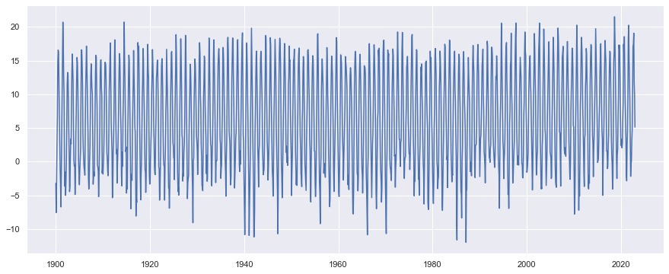
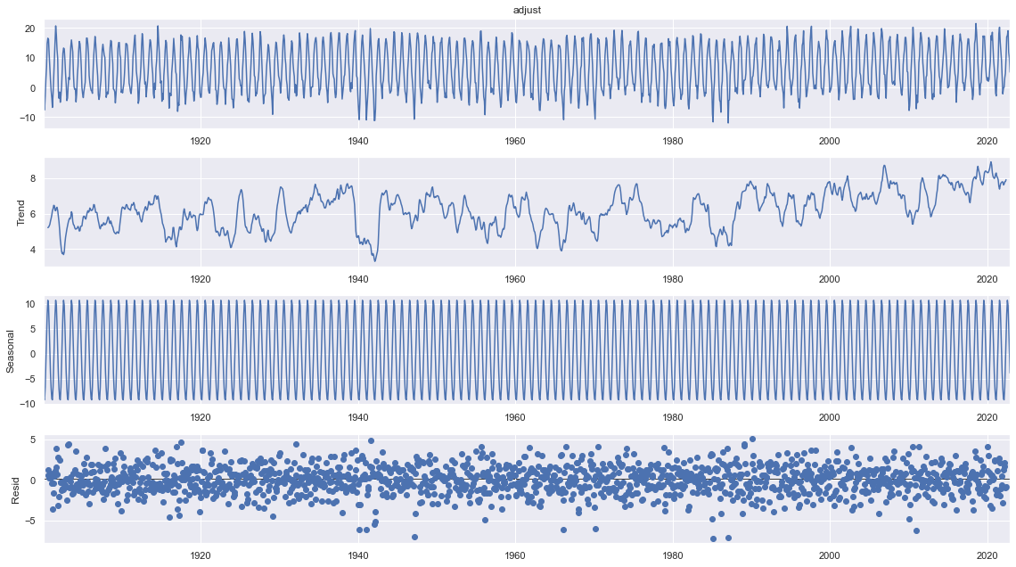
Time series decomposition
The time series appears to have a constant mean and variance over time and presents a strong seasonality pattern.
After the decomposition, there is not a strong observable trend over time. However, it there is a strong seasonal pattern of 12 months.
There was no need for a variance-stabilizing transformation in the data due to the fact that the variance appears to be constant over time.
The database was divided into a “train” and “test” datasets. The first has the 96% of the data and the last one the 4% because the researchers were interested in forecasting the next 5 years.

Slide 5
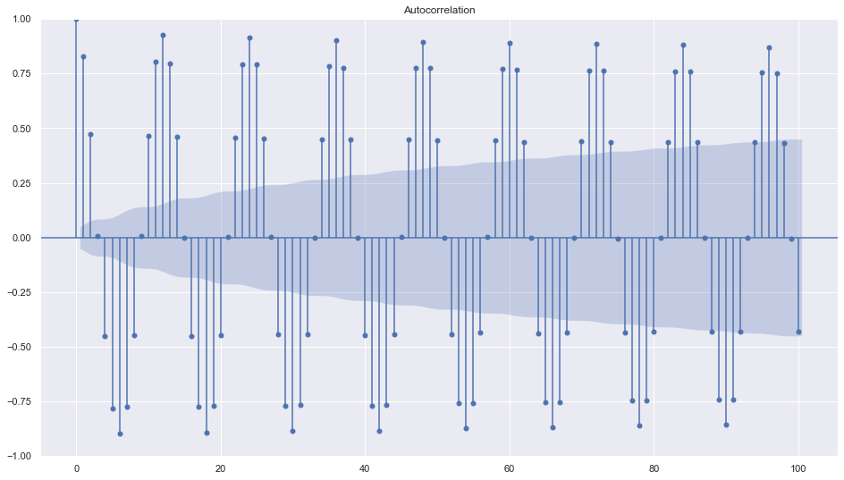
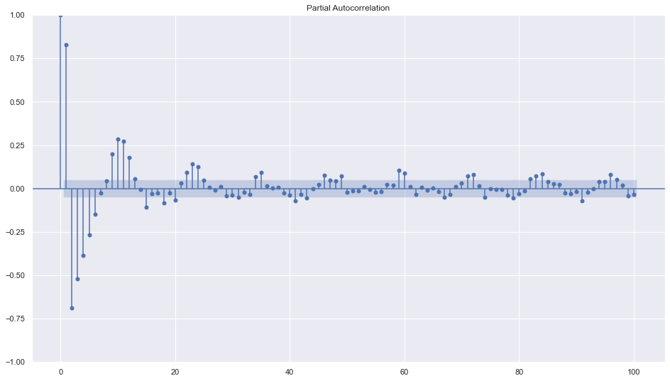
ACF and pacf of original time series
ACF
PACF

Slide 6
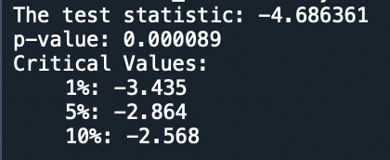
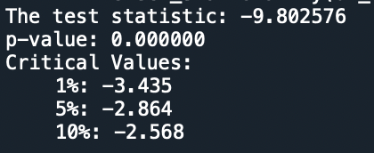
Unit root test
ADF test- original
ADF test- Seasonal Difference

Slide 7
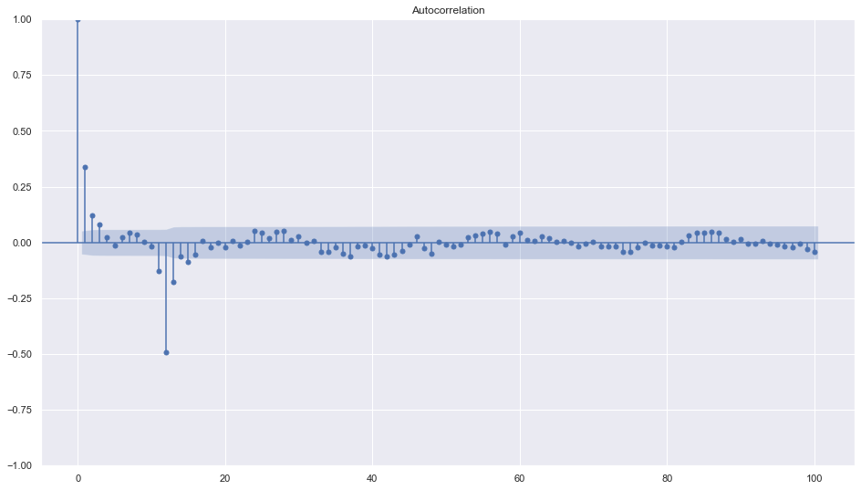
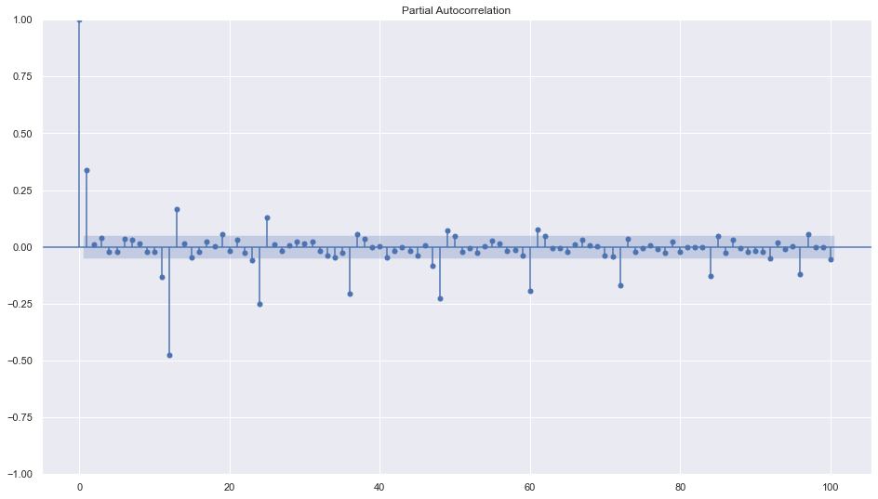
acf and pacf of seasonal differenced ts
The ACF cuts off at the third lag and the seasonal pattern cuts off at lag 12, which suggests a MA(3) model and a SMA(1) model.
The PACF cuts off at the first lag and the seasonal pattern decays exponentially, which suggests a AR(1) model and a SAR(0) model.
ACF of normal TS
PACF of normal TS

Slide 8
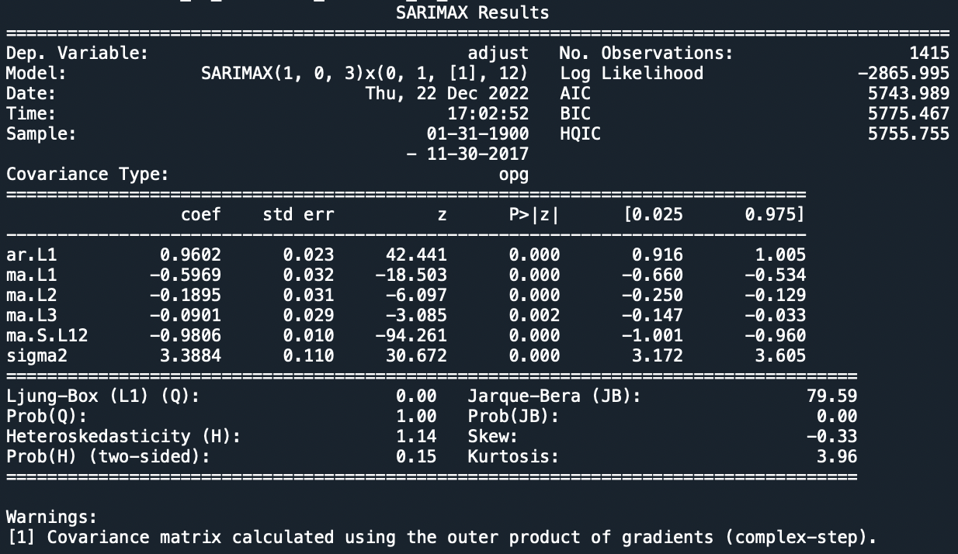
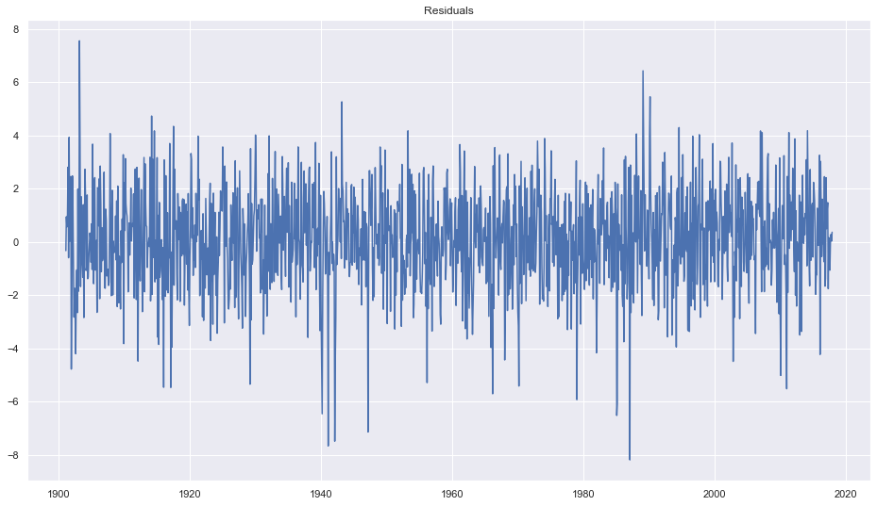
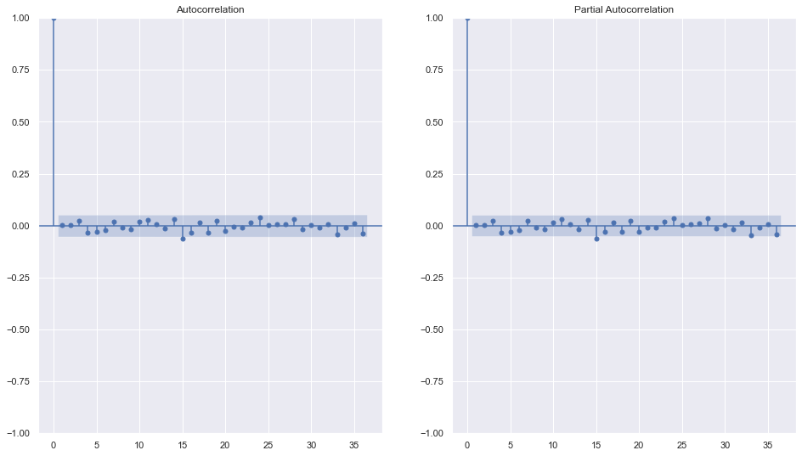
SARIMA (1,0,3)(0,1,1,12) model #1
ESTIMATION RESULTS
Regression errors
ACF
PACF

Slide 9
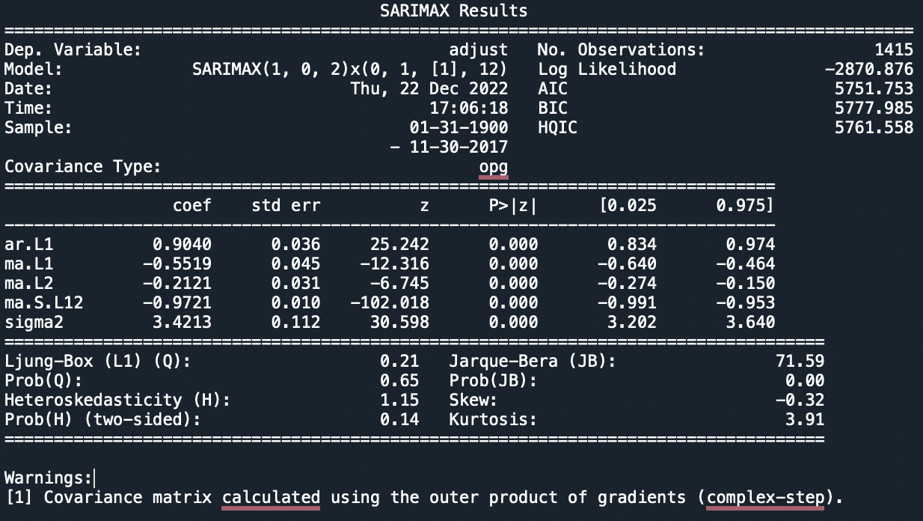
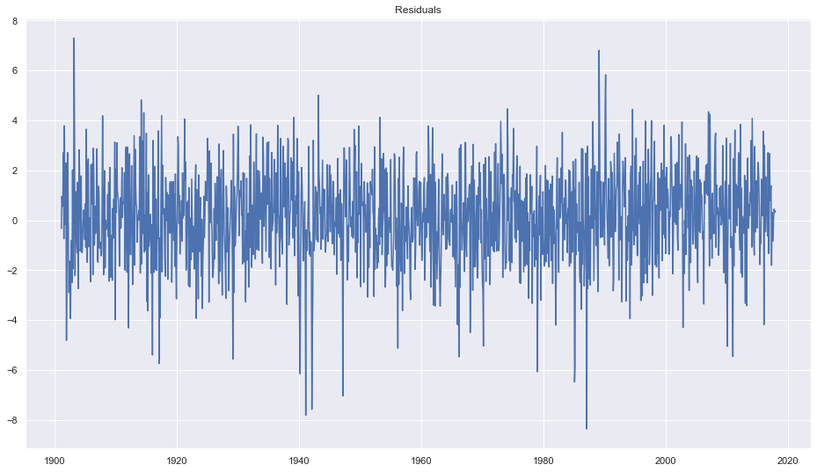

SARIMA (1,0,2)(0,1,1,12) model #2
ESTIMATION RESULTS
Regression errors
ACF
PACF

Slide 10
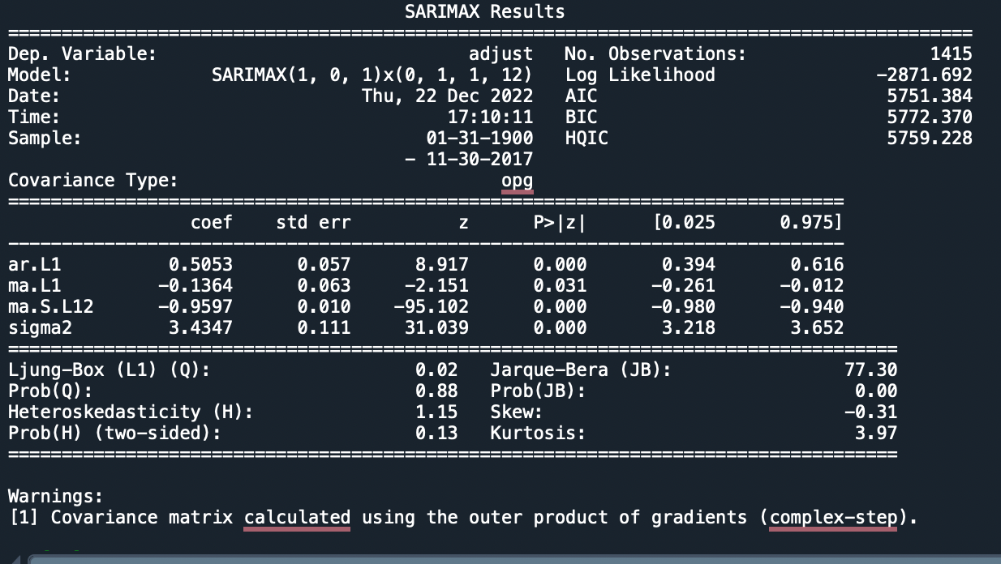
SARIMA (1,0,1)(0,1,1,12) model #3
ESTIMATION RESULTS
Regression errors
ACF
PACF

Slide 11
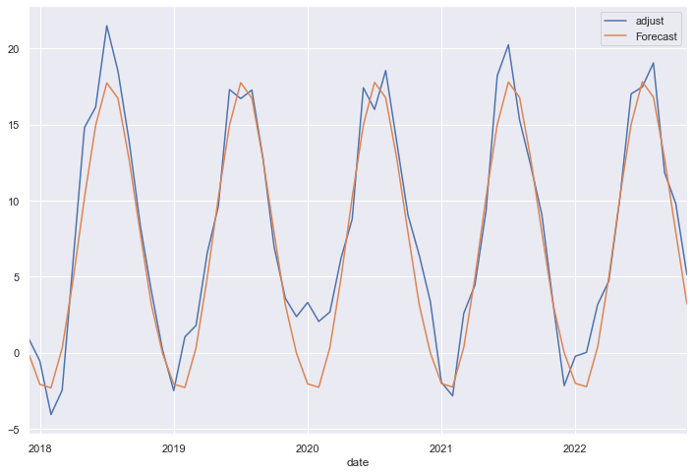
holt-winter’s exponential smoothing model #4
Holt-Winter’s forecasts
An additive trend was selected for this model because there was no apparent trend in the original time series
And additive seasonality was selected for this model because the seasonality of the original time series did not changed over time.

Slide 12
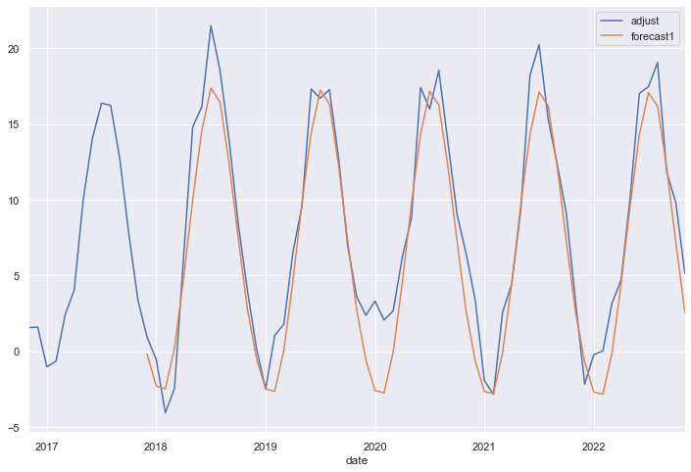

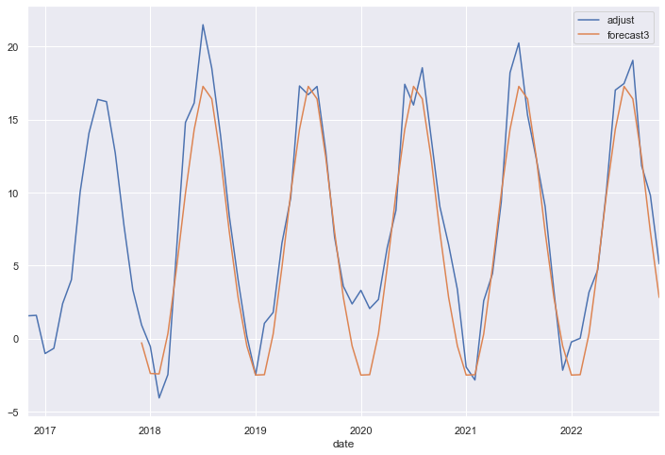
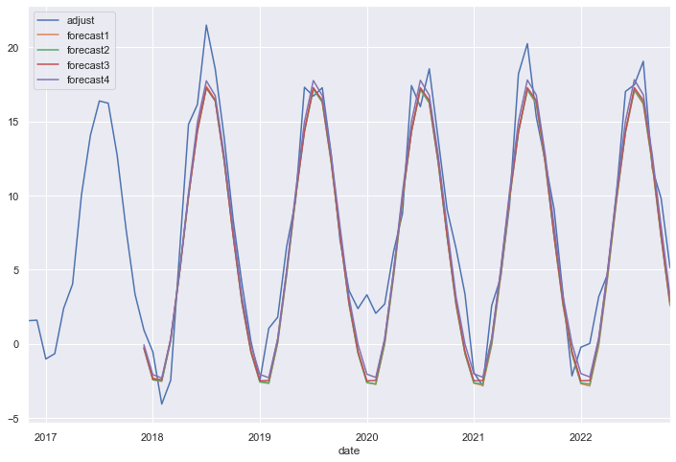
FORECASTS
SARIMA MODEL #1 FORECASTS
SARIMA MODEL #2 FORECASTS
SARIMA MODEL #3 FORECASTS
ALL MODELS FORECASTS

Slide 13
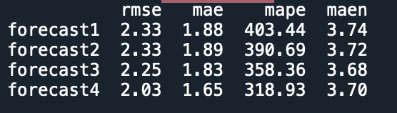
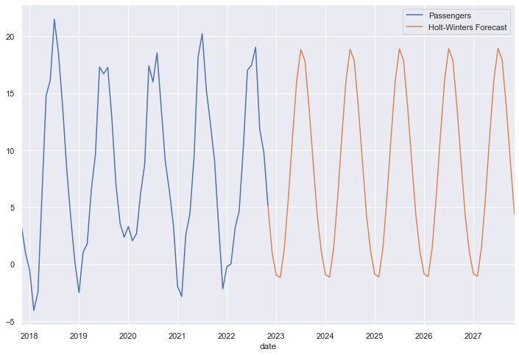
CONCLUSIONS
FORECAST ACCURACY MEASURES
For the SARIMA models, the first one should be selected because it has the minimum values in the AIC and HQIC and the second best in the BIC models selection criteria. However, since it is the one with the maximum values in the RMSE, MAPE and MAEN and the second best in the MAE, none of them were discarded.
Since the Holt-Winters model has the minimum value in the RMSE, MAE and MAPE and the second best in the MAEN, this is the selected model to forecast Stockholm’s Air Temperature for the next 5 years.
HOLT-WINTER’S FORECASTS

